Slide 1

PROTECTING THE UPPER OCONEE RIVER WATERSHED WITH CONSERVATION EASEMENTS & ACEP-ALE
    Krisztian Varsa
    Athens Land Trust
    September 30, 2016

Slide 2
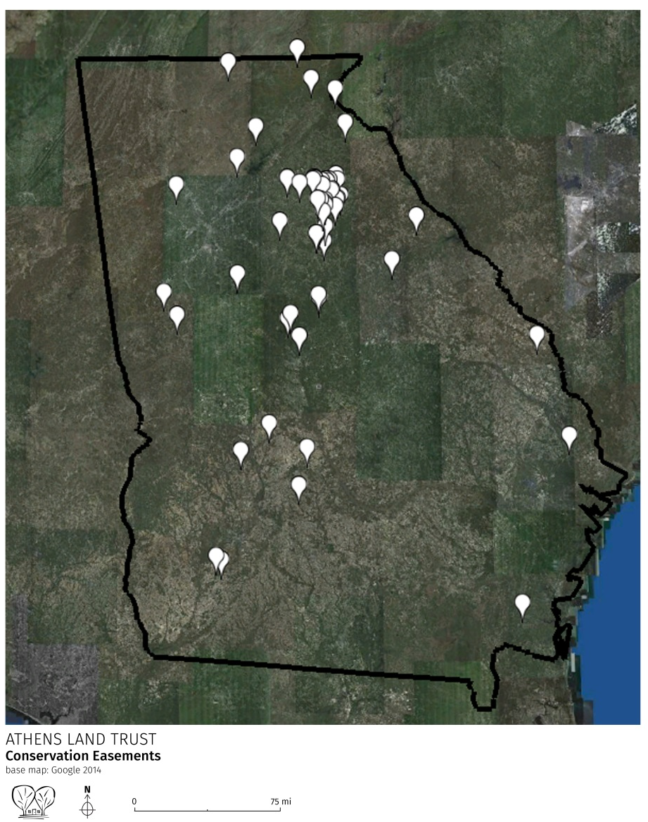
ALT’S CONSERVATION EASEMENTS
13,778 acres protected
28 counties
9 of 14 watersheds
Conservation Resources:
5,077 acres of natural forest
1,625 acres of pasture
883 acres of wetlands
2,189 acres of managed forest

Slide 3
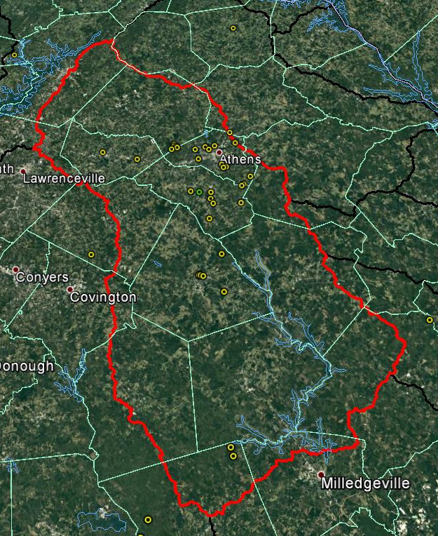
UPPER OCONEE WATERSHED CONSERVATION EASEMENT LANDS
    3,550 acres permanently protected for agriculture, natural resource, and open space
    Provide $7.5 million benefits in air quality, biodiversity protection, water quality, and recreation

Slide 4
WHAT IS A CONSERVATION EASEMENT (CE)?
Owner

Slide 5
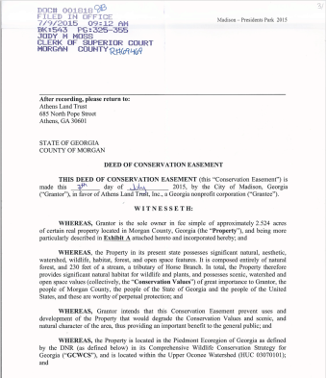
WHAT IS A CE?
Owner
Notes:
(retain possession of the property!)

Slide 6
WHAT IS A CE?
Owner
Notes:
(retain possession of the property!)

Slide 7
VALUATION OF A CE
Fair Market Value (before)
encumbered value (after)
CE value: (30-80%)

Slide 8
ACEP-ALE CE PURCHASE
ACEP = Agricultural Conservation Easement Program
ALE = Agricultural Land Easements
Natural Resources Conservation District (NRCS) program to purchase Conservation Easements on Ag land

Slide 9
VALUATION OF A CE, ACEP-ALE
FMV (before)
encumbered value (after)
CE value: (30-80%)

Slide 10
FRPP / ACEP CE PURCHASE
CE value
NRCS share (50%)
Landowner donation (25%)
Local Match (25%)

Slide 11
FRPP / ACEP CE PURCHASE
CE value
NRCS share (50%) + Local Match (25%) = 75% cash
Landowner donation (25%)

Slide 12
FRPP / ACEP CE PURCHASE
Example
100 acre farm in Oconee County, GA
FMV (HBU) = $10,000/acre = $1,000,000
Encumbered value = $4,000/acre = $400,000
CE value = $1,000,000 - $400,000 = $600,000

Slide 13
FRPP / ACEP CE PURCHASE
CE value = $600,000
NRCS share (50%) + Local Match (25%) = $450,000
Landowner donation (25%)
= $150,000

Slide 14
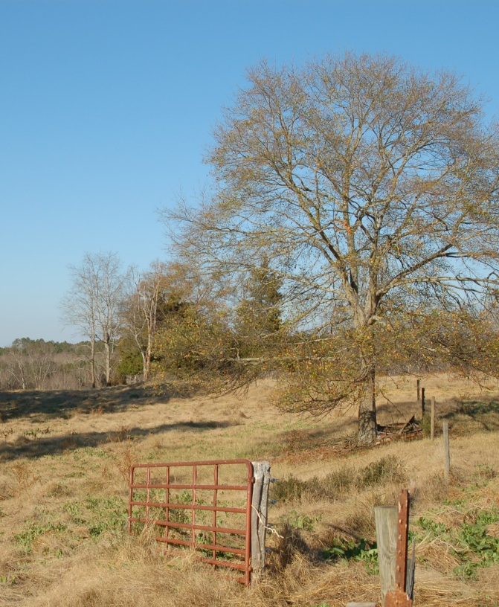
FRPP / ACEP CE PURCHASE
Must meet ACEP program criteria ($1,000 worth
of income from farming)
Property is evaluated through an NRCS ranking process including:
% prime soils
% pasture/grassland/cropland
Historic / archeological significance
Proximity to other protected lands
Etc! (400 points total, national scale)
Two-step process:
Application to ACEP-ALE, receive funding
Athens Land Trust Easement
Can be more restrictive than regular CE

Slide 15
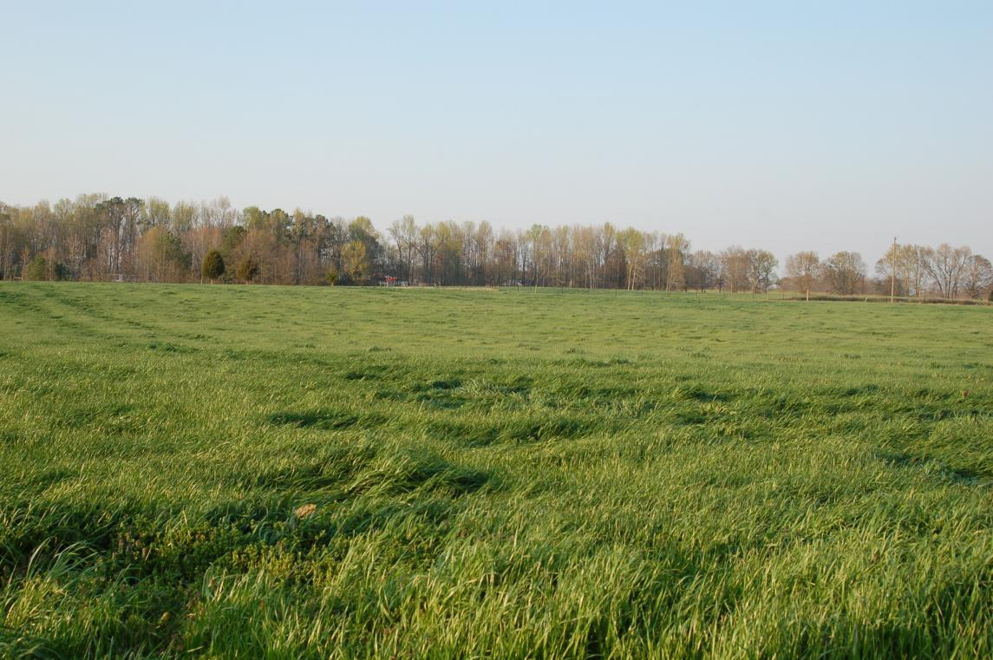
ALT’S FRPP/ACEP-ALE PROJECTS
Hillsman – 30 acres
House – 91.5 acres
Langdale – 63.6 acres
Powers-Breedlove – 133.3 acres
Shelnutt – 42.436 acres
Wiley – 168.408 acres
Ludwig – 51.2 acres
House Property

Slide 16
FRPP / ACEP CE PURCHASE
CE value
NRCS share (50%)
Landowner donation (25%)
??? (25%)

Slide 17
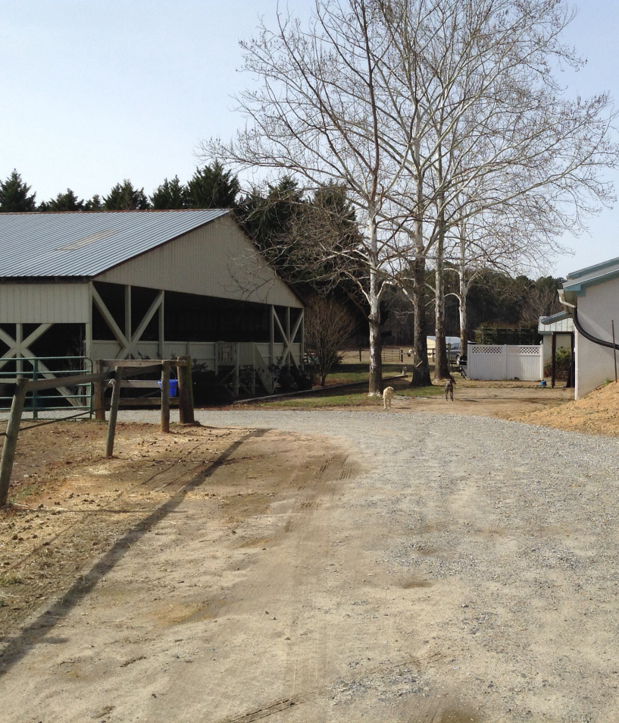
FRPP / ACEP CE OUTREACH
Working with local municipalities, counties, organizations to identify sources for matching funds
  Help create farmland protection programs,
  Identify already existing matching funding streams, or
  Leverage existing protection programs and funds
Oconee County SPLOST: Farmland Preservation Committee
Ludwig Property

Slide 18

THANK YOU!
685 NORTH POPE STREET
ATHENS, GA 30601
706 613 0122
conservation@athenslandtrust.org

